Slide 1
Team 3 ETF Trading Presentation
12th May 2023

Slide 2
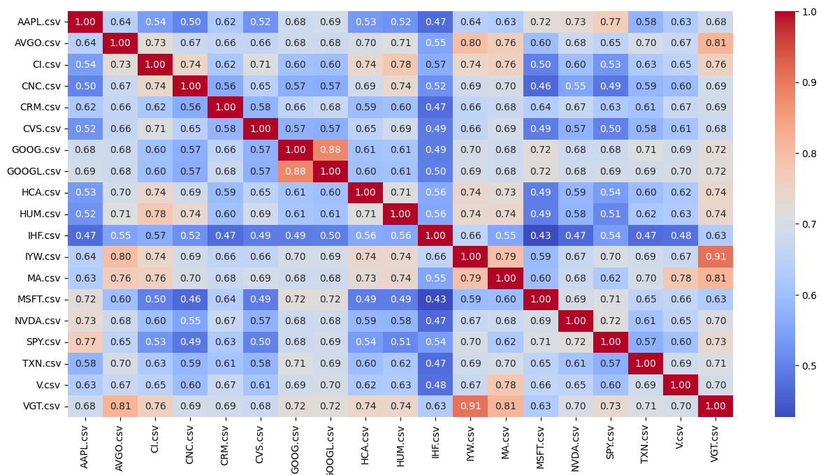
Correlation heat map
VGT and IYW are highly correlated
PAIRS TRADING!

Slide 3
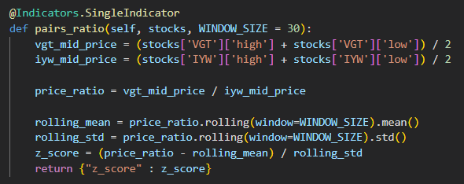
Pairs Trading - Indicator

Slide 4
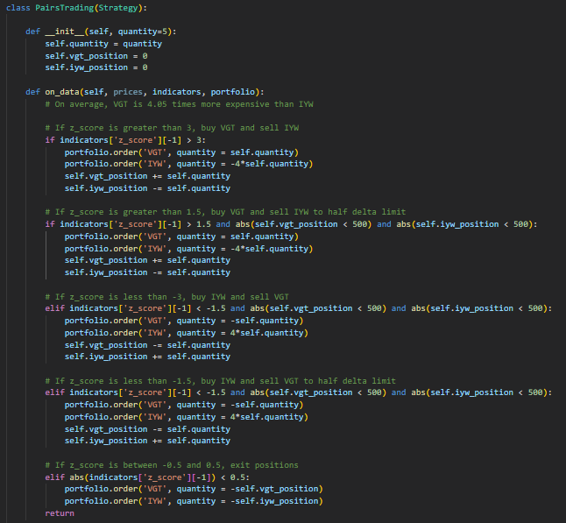
Pairs Trading - Strategy

Slide 5
Pairs Strategy - Results

Slide 6
Volatility

